Slide 1
SPLENDOR INSURANCEANALYTICS DASHBOARD

Slide 2
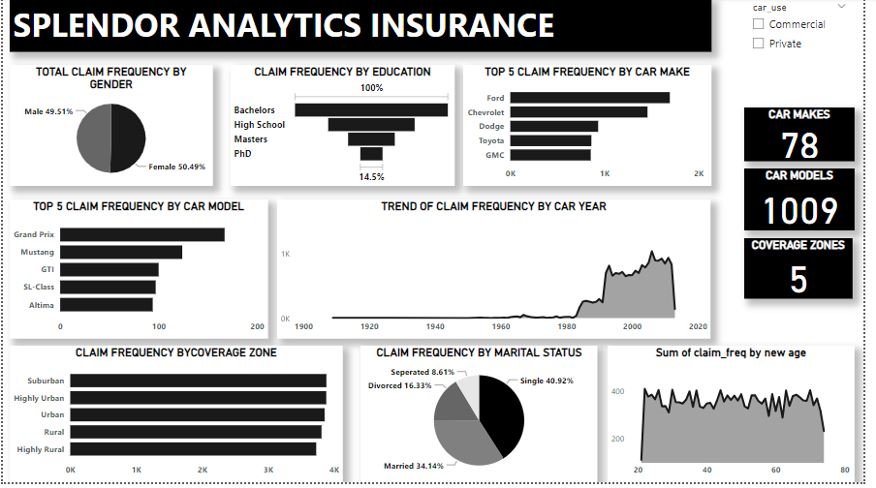
CLAIM FREQUENCY WITHOUT FILTERCY

Slide 3
CLAIM FREQUENCY WITHOUT FILTERS
Without filters,we noticed the following;
Gender –Male scored a percentage total of 50.49% and female,a percentage total of 49.51% on the claim frequency pie chart.
Sender- Male scored a percentage total of 50.49% and Female, a percentage total of 49.51% on the claim frequency pie chart.
Education - Bachelors has the largest claim frequency, followed by high school, then masters. PhD has the lowest Claim frequency.
Car Makes - We looked into a chart of the top 5 car make in respect to claimFrequency, Chevrolet leads, followed by Ford, Dodge and Toyota, Gmc holds 5thposition.
Car Model - Also looked into a chart of the top 5 car model in respect to claim Its pustion, Grand Prix leads, followed by Mustang, GTi and SL-class, Altima holds Car Year - Cars made in 2006 scored highest in the trendline chart against claim
Car Year- Cars made in 2006 scored highest in the trending chart against claim frequency

Slide 4
CLAIM FREQUENCY WITHOUT FILTERS
Coverage Zone - Cars from suburban areas have the most claim frequency, Highly Urban, urban, rural, highly rural came 2nd, 3rd, 4th and 5th respectively.
Marital Status - single policy holders have the most claim frequency, then married, divorced and separated respectively.
Age - policy holders with age 22 claimed the most.

Slide 5
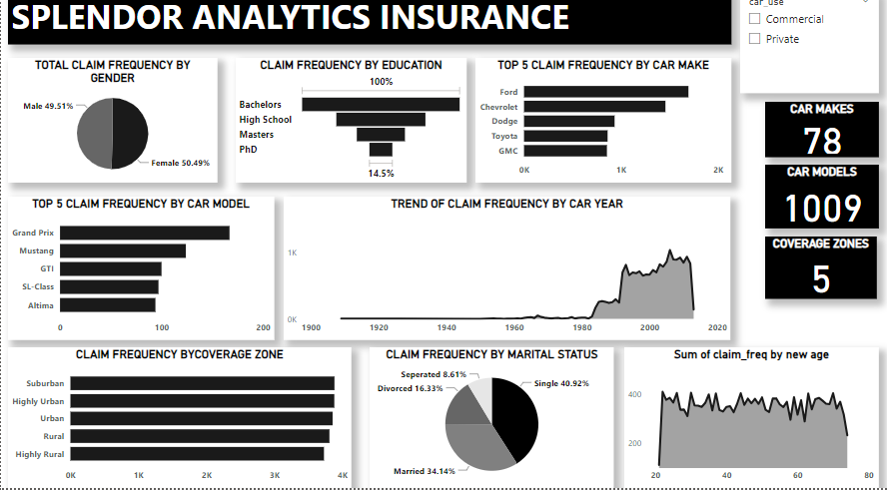
CLAIM FREQUENCY WITH FILTERS COMMERCIAL VEHICLE USERS

Slide 6
CLAIM FREQUENCY WITH FILTERS COMMERCIAL VEHICLE USERS
With commercial vehicle users filter, we noticed the following;
Gender- Male scored a percentage total of 51.57% and Female, a percentage total of 48.43% on the claim frequency pie chart.
Education - Bachelors has the largest claim frequency, followed by High School, then Masters. PhD has the lowest Claim frequency.
Car Makes - We looked into a chart of the top 5 car make in respect to Mitsubssaiend, sChposste-heads, followed by Ford, Dodge and GMC,
Car Model - Also looked into a chart of the top 5 car model in respect to claim frequency, Grand Prix leads, followed by E-class, Corvette and Continental, Es Mirage holds 5th position.
Car Year - Cars made in 2006 scored highest in the trendline chart against claim frequency.

Slide 7
CLAIM FREQUENCY WITH FILTERS COMMERCIAL VEHICLE USERS
Coverage Zone- Cars from highly urban areas have the most claim frequency ,urban ,highly rural, rural ,suburban came 2nd ,3rd ,4th and 5th respectively.
Marital status- single policy holders have the most claim frequency ,then married ,divorced and separated respectively.
Age- policy holders with age 22 claimed the most.

Slide 8
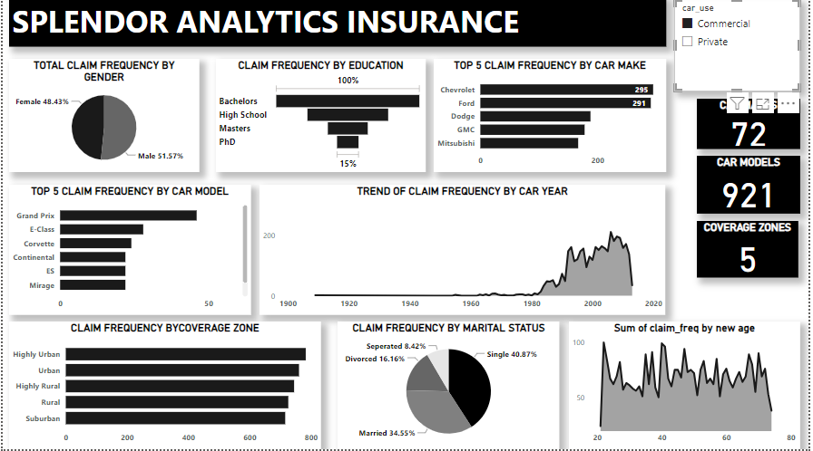
CLAIM FREQUENCY WITH FILTERS-PRIVATE VEHICLE USERS

Slide 9
CLAIM FREQUENCY WITH FILTERS COMMERCIAL VEHICLES USERS
With private vehicle users filter, we noticed the following;
Gender- Male scored a percentage total of 49.01% and Female, a percentage total of 50.99% on the claim frequency pie chart.
Education - Bachelors has the largest claim frequency, followed by high school, then masters. PhD has the lowest Claim frequency.
Car Makes - We looked into a chart of the top 5 car make in respect to claim frequency, ford leads, followed by Chevrolet, dodge and toyota, gmeholds 5th position.
Car Model - Also looked into a chart of the top 5 car model in respect toclaim frequency,camaro/thunderbird holds 5th position,Grand Prix leads, followed by mustang, gti and altima,camaro/thunderbird hold 5th position.
Car Year- Cars made in 2006 scored highest in the trendline chart against claim frequency.

Slide 10
CLAIM FREQUENCY WITH FILTERS-PRIVATE VEHICLE USERS
Coverage Zone-Cars from suburbanareas have the most claim frequency ,highly urban ,urban ,rural ,highly rural came 2nd 3rd
,4th ,and 5th respectively
Marital Status- single policy holdres have the most claim frequency ,them married ,divorced and separated respectively
Age- policy holders with age 30 claimed the most

